Slide 1
W4111 – Introduction to Databases Section 002, Fall 2025 Lecture 5: Foundation – ER, Relational, SQL (4)
COMSW4111_002_2026_1- Foundation – ER, Relational, SQL (2) © Donald F. Ferguson, 2025

Slide 2
Contents

Slide 3
Notes and Content
ER Model/Modeling
Relationship degree and cardinality
Aggregation
Relational algebra
Some complex examples
More fun with the RelaX calculator
SQL
Loading Classic Models dataset.
Indexes
Advanced Windows Functions
Recursive queries
Procedures, functions and triggers
Using a programming language
Project concepts: (Web) applications, REST, data engineering

Slide 4
ER Model/ER Modeling

Slide 5
Degree
Cardinality

Slide 6
Degree of a Relationship Set
Binary relationship
involve two entity sets (or degree two).
most relationship sets in a database system are binary.
Relationships between more than two entity sets are rare. Most relationships are binary. (More on this later.)
Example: students work on research projects under the guidance of an instructor.
relationship proj_guide is a ternary relationship between instructor, student, and project

Slide 7
Non-binary Relationship Sets
Most relationship sets are binary
There are occasions when it is more convenient to represent relationships as non-binary.
E-R Diagram with a Ternary Relationship

Slide 8
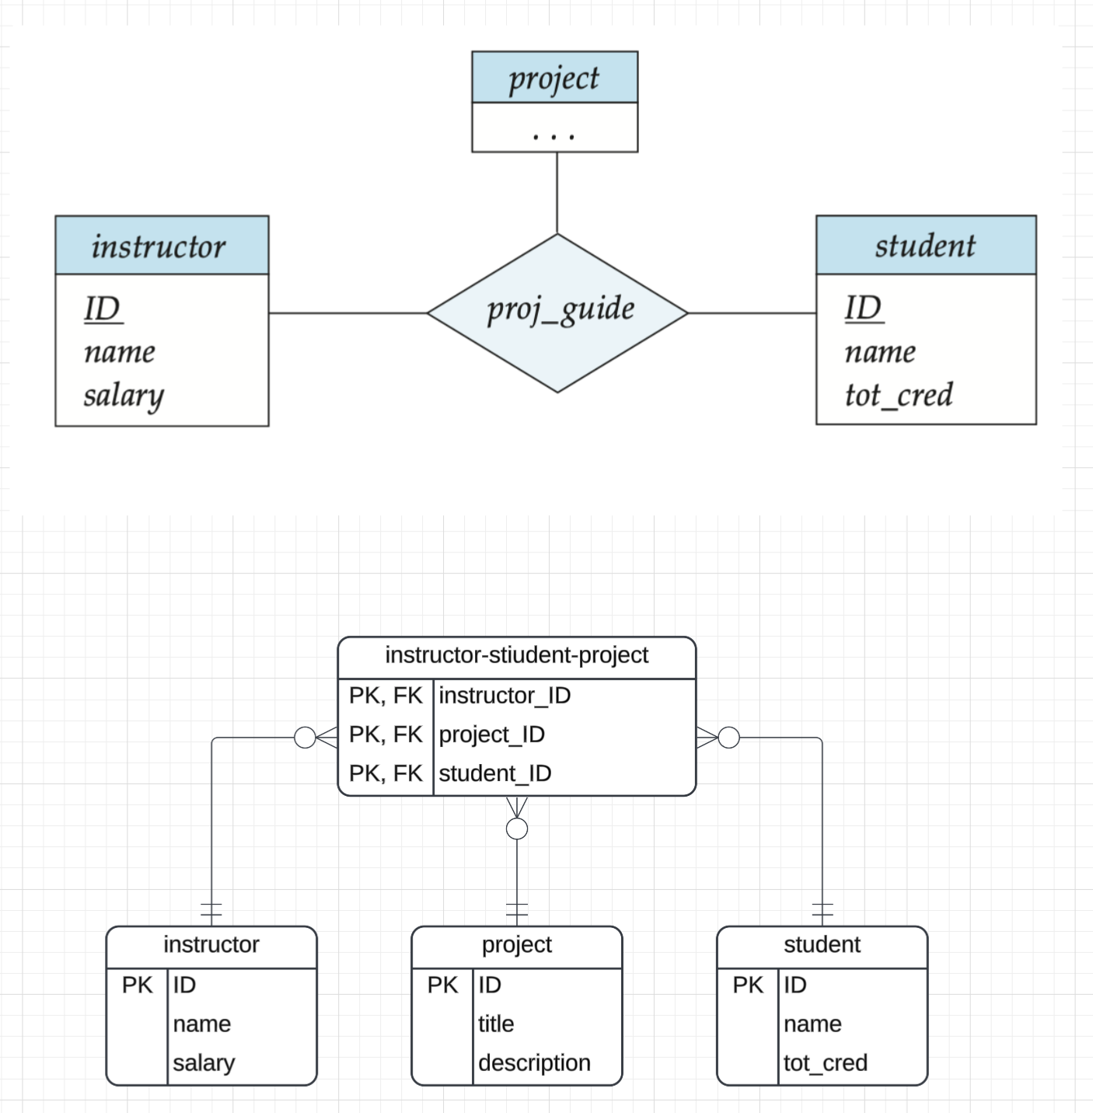
Crow’s Foot
Similar to many-to-many, represent the relationship with an associative entity.

Slide 9
Mapping Cardinality Constraints
Express the number of entities to which another entity can be associated via a relationship set.
Most useful in describing binary relationship sets.
For a binary relationship set the mapping cardinality must be one of the following types:
One to one
One to many
Many to one
Many to many

Slide 10
Representing Cardinality Constraints in ER Diagram
We express cardinality constraints by drawing either a directed line (→), signifying “one,” or an undirected line (—), signifying “many,” between the relationship set and the entity set.
One-to-one relationship between an instructor and a student :
A student is associated with at most one instructor via the relationship advisor
A student is associated with at most one department via stud_dept
This actually means that
A student is associated with at most one advisor.
An instructor advises at most one student.
Implies that the relationship is bi-directional, (instructor, student) come in pairs.

Slide 11
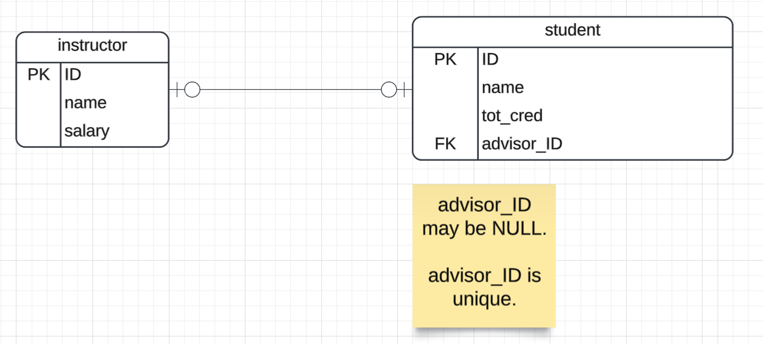
Crow’s Foot

Slide 12
One-to-Many Relationship
one-to-many relationship between an instructor and a student
an instructor is associated with several (including 0) students via advisor
a student is associated with at most one instructor via advisor,

Slide 13
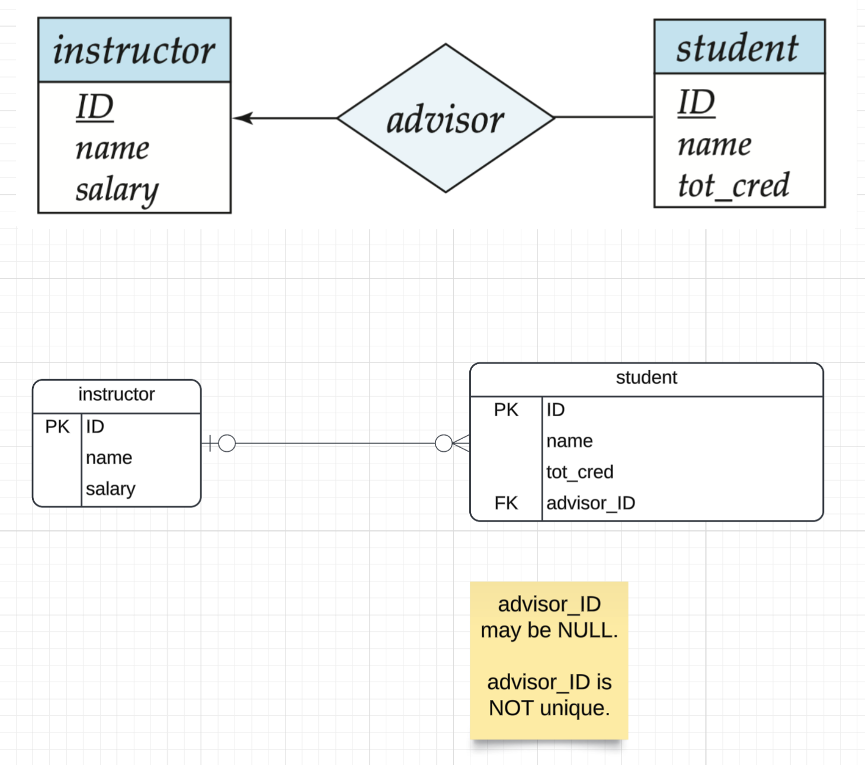
Crow’s Foot

Slide 14
Many-to-One Relationships
In a many-to-one relationship between an instructor and a student,
an instructor is associated with at most one student via advisor,
and a student is associated with several (including 0) instructors via advisor
This is basically the same as the previous one, only the FK goes on the other end.

Slide 15
Many-to-Many Relationship
An instructor is associated with several (possibly 0) students via advisor
A student is associated with several (possibly 0) instructors via advisor
We handle this with an associative entity.

Slide 16
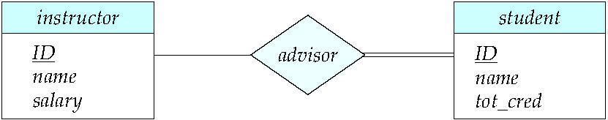
Total and Partial Participation
Total participation (indicated by double line): every entity in the entity set participates in at least one relationship in the relationship set
participation of student in advisor relation is total
every student must have an associated instructor
Partial participation: some entities may not participate in any relationship in the relationship set
Example: participation of instructor in advisor is partial

Slide 17
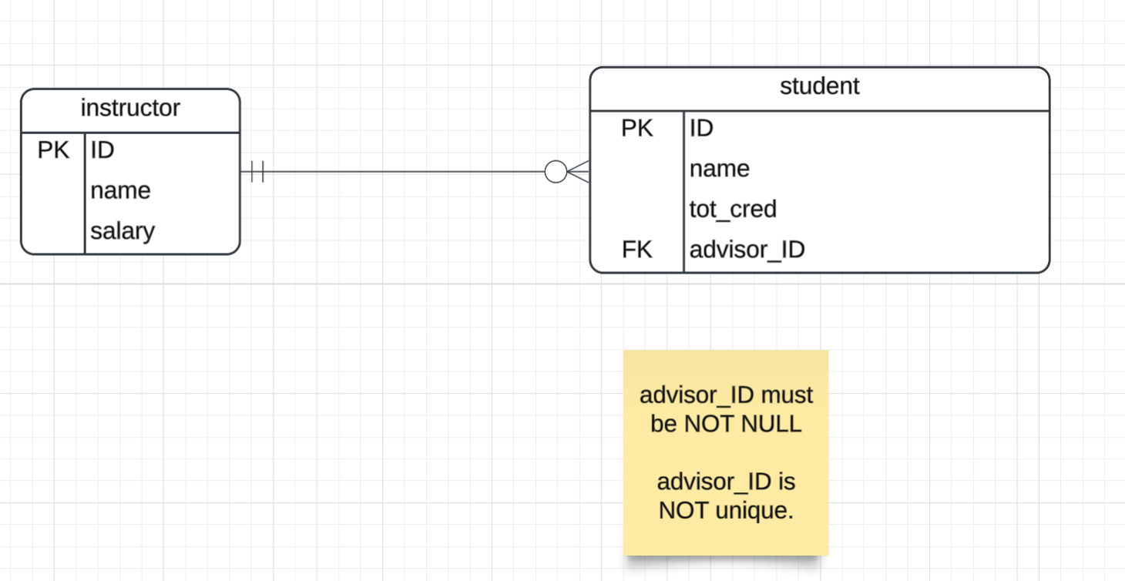
Crow’s Foot

Slide 18
Notation for Expressing More Complex Constraints
A line may have an associated minimum and maximum cardinality, shown in the form l..h, where l is the minimum and h the maximum cardinality
A minimum value of 1 indicates total participation.
A maximum value of 1 indicates that the entity participates in at most one relationship
A maximum value of * indicates no limit.
Example
Instructor can advise 0 or more students. A student must have 1 advisor; cannot have multiple advisors
There’s no way to do this in Crow’s Foot.
Implementing 1..h is tricky in RDBMS and requires and associative entity and/or triggers.

Slide 19
Aggregation

Slide 20
Aggregation
Consider the ternary relationship proj_guide, which we saw earlier
Suppose we want to record evaluations of a student by a guide on a project

Slide 21
Aggregation (Cont.)
Relationship sets eval_for and proj_guide represent overlapping information
Every eval_for relationship corresponds to a proj_guide relationship
However, some proj_guide relationships may not correspond to any eval_for relationships
So we can’t discard the proj_guide relationship
Eliminate this redundancy via aggregation
Treat relationship as an abstract entity
Allows relationships between relationships
Abstraction of relationship into new entity

Slide 22
Aggregation (Cont.)
Eliminate this redundancy via aggregation without introducing redundancy, the following diagram represents:
A student is guided by a particular instructor on a particular project
A student, instructor, project combination may have an associated evaluation
The simplest way to handle in relational is an associative entity.
Some thoughts here: https://www.geeksforgeeks.org/aggregate-data-model-in-nosql/
Notes:
22

Slide 23
Reduction to Relational Schemas
To represent aggregation, create a schema containing
Primary key of the aggregated relationship,
The primary key of the associated entity set
Any descriptive attributes
In our example:
The schema eval_for is:
eval_for (s_ID, project_id, i_ID, evaluation_id)
The schema proj_guide is redundant.

Slide 24
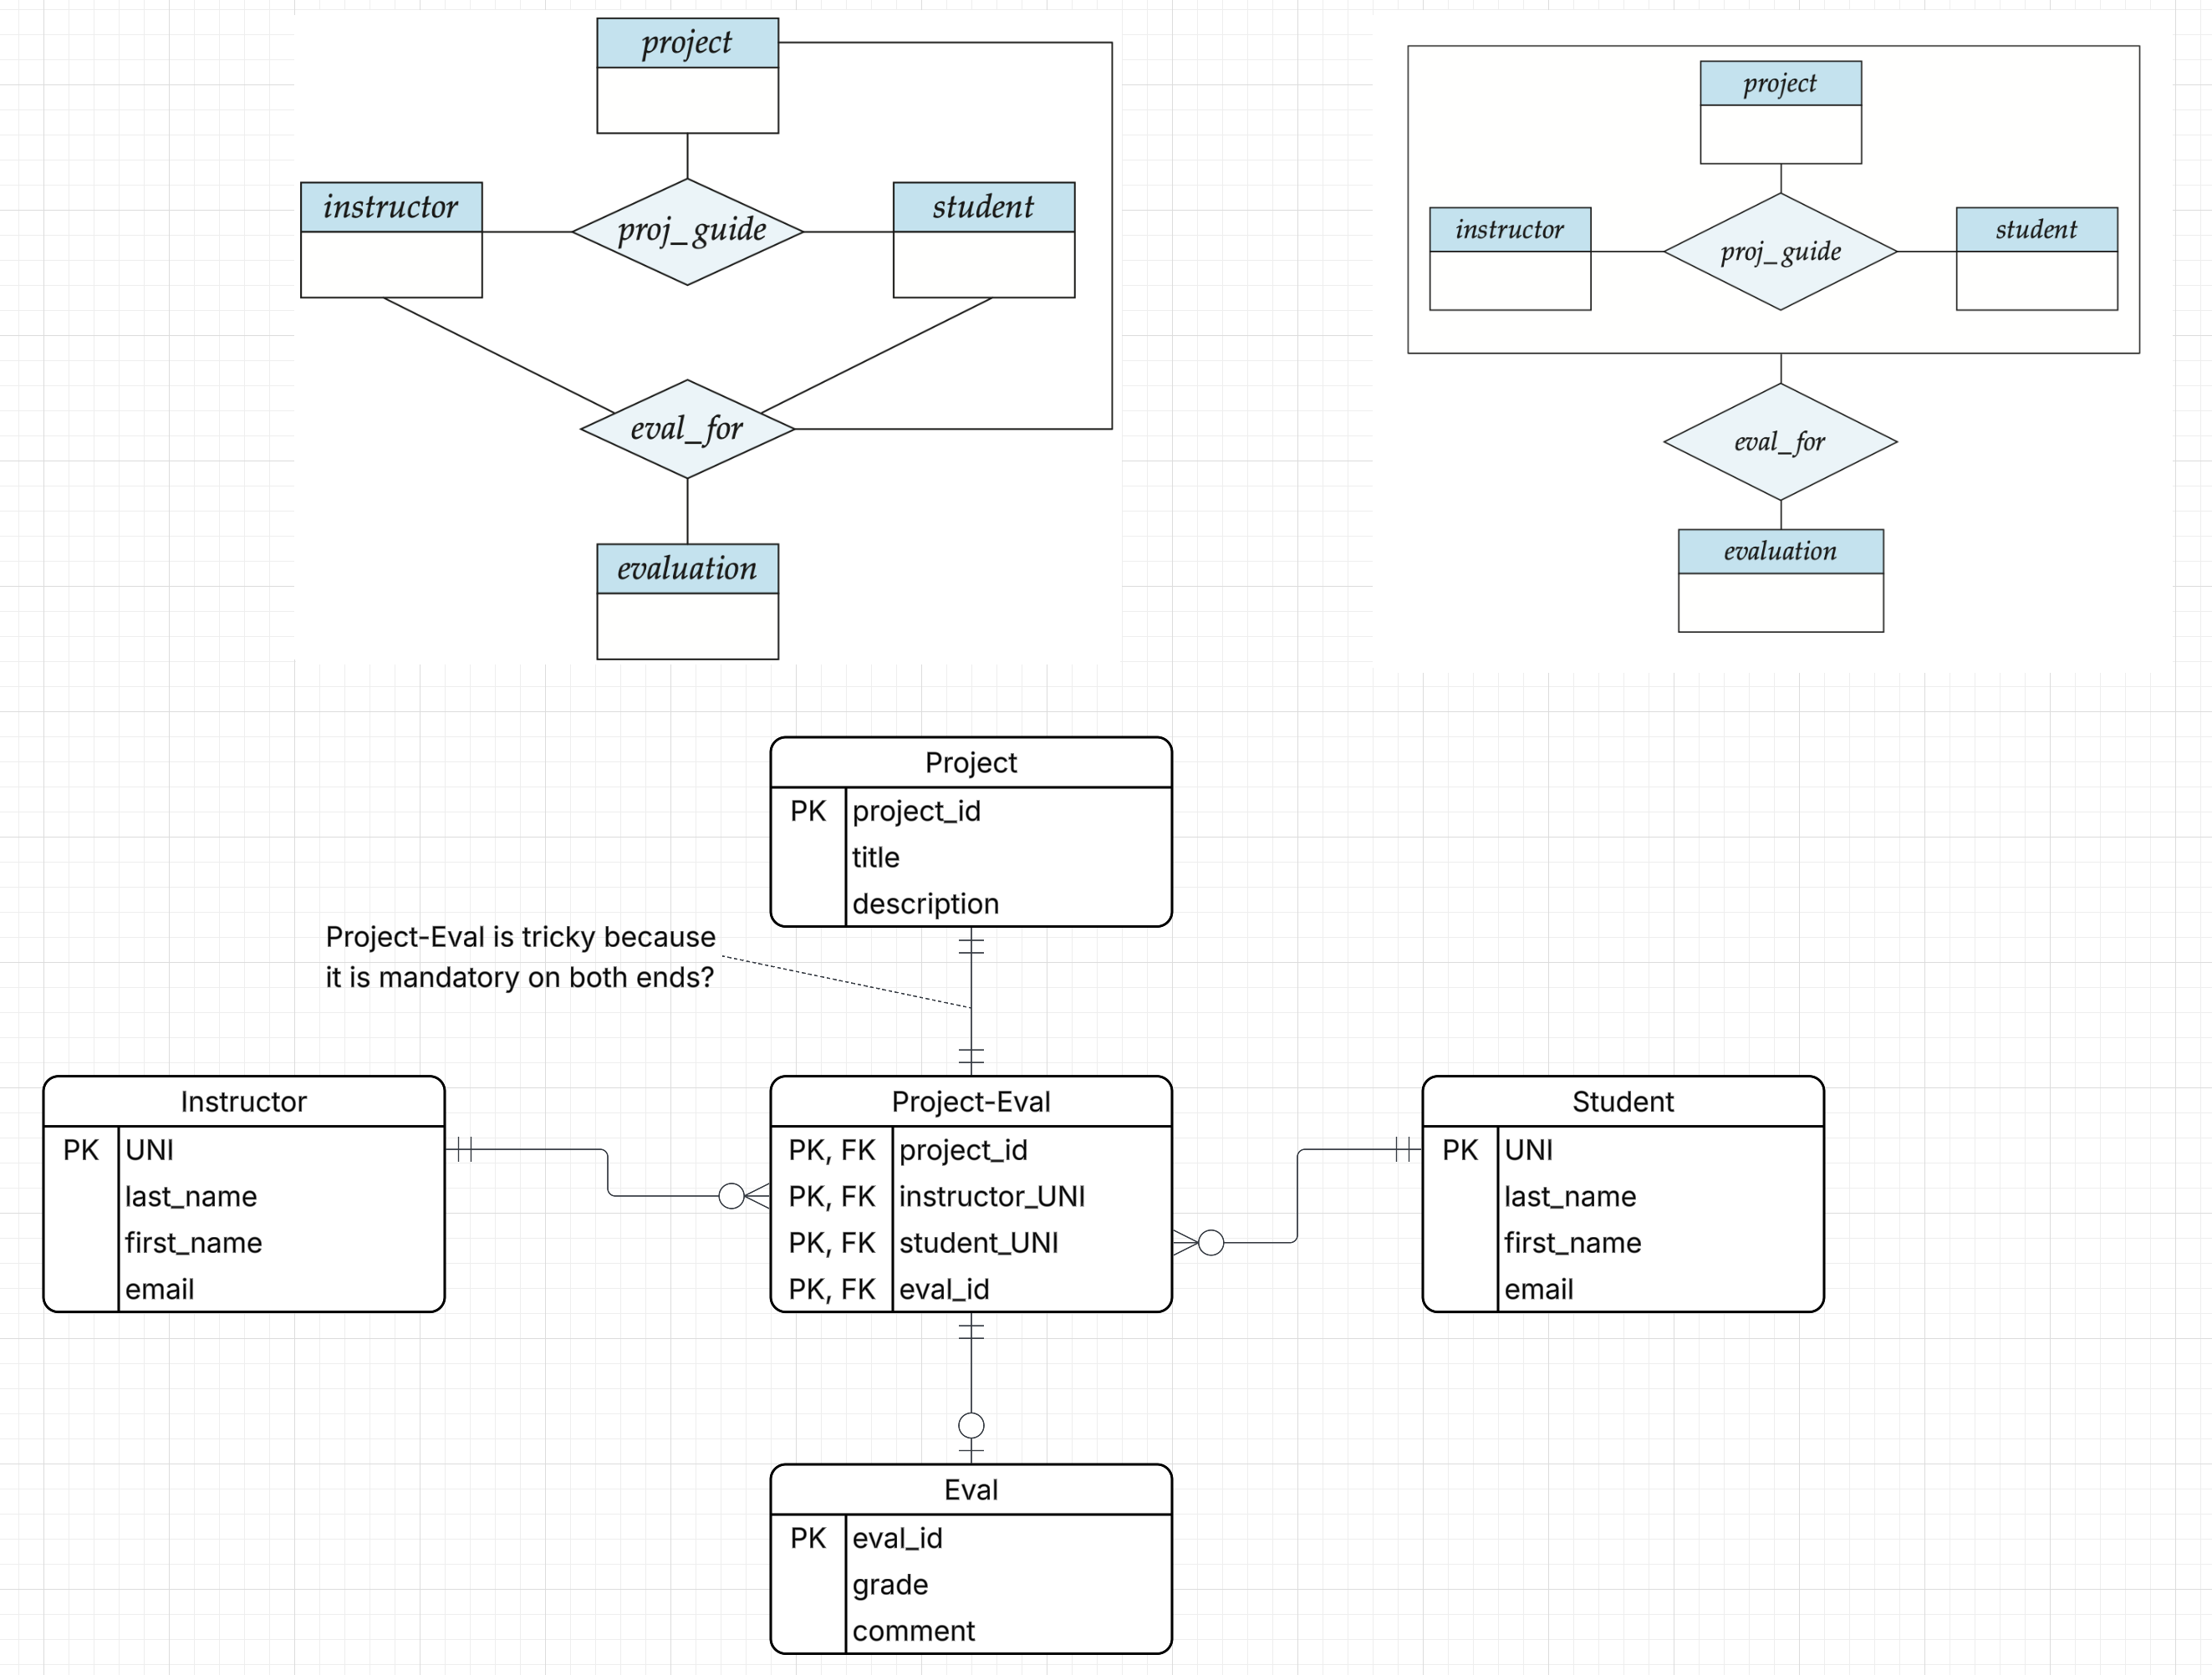
Let’s Do a More Example in Crow’s Foot
If I got that right, it is a miracle. Normally, you cannot be sure until you implement and test it.

Slide 25
Relational Databases/SQL

Slide 26
Load Classic Models
(Show how to load Classic Models in DataGrip) (Explain how I could also do this from the command line) (Walk through SQL Script)

Slide 27
Indexes

Slide 28
Index Creation
Many queries reference only a small proportion of the records in a table.
It is inefficient for the system to read every record to find a record with particular value
An index on an attribute of a relation is a data structure that allows the database system to find those tuples in the relation that have a specified value for that attribute efficiently, without scanning through all the tuples of the relation.
We create an index with the create index command
create index <name> on <relation-name> (attribute);

Slide 29
Index Creation Example
create table student (ID varchar (5), name varchar (20) not null, dept_name varchar (20), tot_cred numeric (3,0) default 0, primary key (ID))
create index studentID_index on student(ID)
The query:
select * from student where ID = '12345'
can be executed by using the index to find the required record, without looking at all records of student
DFF:
An index on (column1, column2, column3)
Is also an index on (column1) and (column1, column2)
But not (column2), (column3), (column2, column3).
We will see “why” later in the semester.
Show performance in Notebook

Slide 30
Advanced Windows Functions

Slide 31
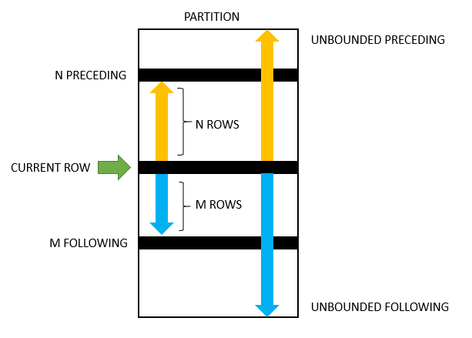
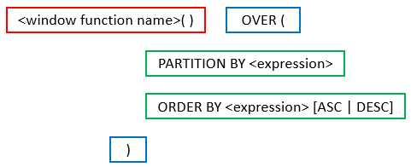
Advanced Aggregates and Window Functions
The aggregation functions in SQL are powerful.
There are some scenarios that are very difficult. SQL and databases add support for more advanced capabilities:
Ranking
Windows
Pivot, Slice and Dice, but we will cover these with a different technology (OLAP) later in the semester.
This is powerful, a little complex and requires trial and error.

Slide 32
Classic Models: Annual Revenue and YoY Growth by Country
SELECT country, YEAR(orderDate) AS year, ROUND(SUM(priceEach * quantityOrdered), 2) AS annual_revenue, ROUND( (SUM(priceEach * quantityOrdered) - LAG(SUM(priceEach * quantityOrdered)) OVER (PARTITION BY country ORDER BY YEAR(orderDate))) / LAG(SUM(priceEach * quantityOrdered)) OVER (PARTITION BY country ORDER BY YEAR(orderDate)) * 100, 2 ) AS yoy_growth_percentage FROM customers JOIN orders ON customers.customerNumber = orders.customerNumber JOIN orderdetails ON orders.orderNumber = orderdetails.orderNumber GROUP BY country, year ORDER BY country, year;

Slide 33
Revenue and Growth Quarter to Quarter
WITH quarterly_revenue AS (
SELECT
YEAR(o.orderDate) AS order_year, QUARTER(o.orderDate) AS order_quarter, SUM(od.quantityOrdered * od.priceEach) AS revenue
FROM
orders o JOIN orderdetails od ON o.orderNumber = od.orderNumber WHERE o.status = 'Shipped'
GROUP BY YEAR(o.orderDate), QUARTER(o.orderDate)
)
SELECT
qr.order_year, qr.order_quarter, qr.revenue,
LAG(qr.revenue) OVER (ORDER BY qr.order_year, qr.order_quarter) AS previous_quarter_revenue,
ROUND(
(qr.revenue - LAG(qr.revenue) OVER (ORDER BY qr.order_year, qr.order_quarter))
/ LAG(qr.revenue) OVER (ORDER BY qr.order_year, qr.order_quarter) * 100,
2
) AS qoq_growth_percent
FROM
quarterly_revenue qr
ORDER BY
qr.order_year, qr.order_quarter;

Slide 34
Summary
These are powerful and useful capabilities.
They are part of the SQL 2003 standard.
Implementation may differ from RDB implementation to RDB implementation.
I will not ask you questions on exams. I will ask questions on homework. You can do what I do and ask ChatGPT because I keep forgetting how do to it.

Slide 35
Recursive Queries

Slide 36
Recursion in SQL
SQL:1999 permits recursive view definition
Example: find which courses are a prerequisite, whether directly or indirectly, for a specific course with recursive rec_prereq(course_id, prereq_id) as ( select course_id, prereq_id from prereq union select rec_prereq.course_id, prereq.prereq_id, from rec_rereq, prereq where rec_prereq.prereq_id = prereq.course_id ) select ∗ from rec_prereq;
This example view, rec_prereq, is called the transitive closure of the prereq relation

Slide 37
The Power of Recursion
Recursive views make it possible to write queries, such as transitive closure queries, that cannot be written without recursion or iteration.
Intuition: Without recursion, a non-recursive non-iterative program can perform only a fixed number of joins of prereq with itself
This can give only a fixed number of levels of managers
Given a fixed non-recursive query, we can construct a database with a greater number of levels of prerequisites on which the query will not work
Alternative: write a procedure to iterate as many times as required
See procedure findAllPrereqs in book

Slide 38
The Power of Recursion
Computing transitive closure using iteration, adding successive tuples to rec_prereq
The next slide shows a prereq relation
Each step of the iterative process constructs an extended version of rec_prereq from its recursive definition.
The final result is called the fixed point of the recursive view definition.
Recursive views are required to be monotonic. That is, if we add tuples to prereq the view rec_prereq contains all of the tuples it contained before, plus possibly more
This is from the book.
There is a typo in the query.
I cannot figure out what they are trying to accomplish.
The data is not complex enough to justify recursion. See the following example.

Slide 39
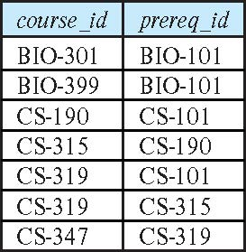
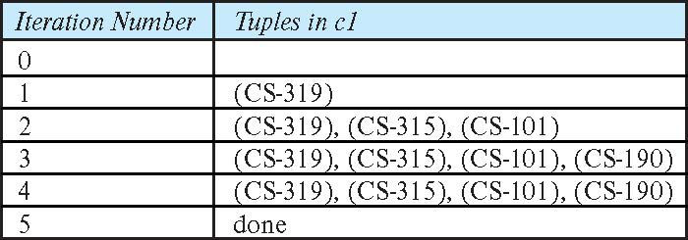
Example of Fixed-Point Computation

Slide 40
Classic Models Management Chain
WITH RECURSIVE employee_chain AS ( -- Base case: Start with employees who do not report to anyone (top-level managers) SELECT employeeNumber AS employee_id, reportsTo AS manager_id, CONCAT(firstName, ' ', lastName) AS employee_name, CAST(employeeNumber AS CHAR(100)) AS management_chain FROM employees WHERE reportsTo IS NULL UNION ALL -- Recursive step: Add employees who report to employees already in the chain SELECT e.employeeNumber AS employee_id, e.reportsTo AS manager_id, CONCAT(e.firstName, ' ', e.lastName) AS employee_name, CONCAT(ec.management_chain, ' -> ', e.employeeNumber) AS management_chain FROM employees e JOIN employee_chain ec ON e.reportsTo = ec.employee_id ) SELECT employee_id, employee_name, management_chain FROM employee_chain ORDER BY management_chain;

Slide 41

Recursive Query

Slide 42

Functions, Procedures and Trigger Concepts
42 | COMS W4111_002_2025_1 - Lecture 5: ER(4), Relational(4), SQL(4) © Donald F. Ferguson, 2025

Slide 43
Functions and Procedures
Functions and procedures allow “business logic” to be stored in the database and executed from SQL statements.
These can be defined either by the procedural component of SQL or by an external programming language such as Java, C, or C++.
The syntax we present here is defined by the SQL standard.
Most databases implement nonstandard versions of this syntax.
Note:
The programming language, runtime and tools for functions, procedures and triggers are not easy to use.
My view is that calling external functions is an anti-pattern (bad idea).
External code degrades the reliability, security and performance of the database.
Databases are often mission critical and the heart of environments.

Slide 44
Language Constructs for Procedures & Functions
SQL supports constructs that gives it almost all the power of a general-purpose programming language.
Warning: most database systems implement their own variant of the standard syntax below.
Compound statement: begin … end, {}
May contain multiple SQL statements between begin and end.
Local variables can be declared within a compound statements
While and repeat statements:
while boolean expression do
sequence of statements ;
end while
repeat
sequence of statements ;
until boolean expression
end repeat

Slide 45
(Core) Language Constructs (Cont.)
For loop
Permits iteration over all results of a query
Example: Find the budget of all departments declare n integer default 0; for r as select budget from department where dept_name = 'Music' do set n = n + r.budget end for
Note:
There are various other looping constructs.

Slide 46
(Core) Language Constructs – if-then-else
Conditional statements (if-then-else)
if boolean expression then statement or compound statement elseif boolean expression then statement or compound statement else statement or compound statement end if
Note:
We will not spend a lot of time writing functions, procedures, or triggers.
The language and development environment are not easy to use.

Slide 47
Functions
47 | COMS W4111_002_2025_1 - Lecture 5: ER(4), Relational(4), SQL(4) © Donald F. Ferguson, 2025

Slide 48
Declaring SQL Functions
Define a function that, given the name of a department, returns the count of the number of instructors in that department.
create function dept_count (dept_name varchar(20)) returns integer begin declare d_count integer; select count (* ) into d_count from instructor where instructor.dept_name = dept_name return d_count; end
The function dept_count can be used to find the department names and budget of all departments with more that 12 instructors.
select dept_name, budget from department where dept_count (dept_name ) > 12

Slide 49
Table Functions
The SQL standard supports functions that can return tables as results; such functions are called table functions
Example: Return all instructors in a given department
create function instructor_of (dept_name char(20))
returns table (
ID varchar(5), name varchar(20), dept_name varchar(20), salary numeric(8,2))
return table (select ID, name, dept_name, salary from instructor where instructor.dept_name = instructor_of.dept_name)
Usage
select * from table (instructor_of ('Music'))

Slide 50
Procedures
50 | COMS W4111_002_2025_1 - Lecture 5: ER(4), Relational(4), SQL(4) © Donald F. Ferguson, 2025

Slide 51
SQL Procedures
The dept_count function could instead be written as procedure:
create procedure dept_count_proc (in dept_name varchar(20), out d_count integer) begin
select count(*) into d_count from instructor where instructor.dept_name = dept_count_proc.dept_name
end
The keywords in and out are parameters that are expected to have values assigned to them and parameters whose values are set in the procedure in order to return results.
Procedures can be invoked either from an SQL procedure or from embedded SQL, using the call statement.
declare d_count integer; call dept_count_proc( 'Physics', d_count);

Slide 52
SQL Procedures (Cont.)
Procedures and functions can be invoked also from dynamic SQL
SQL allows more than one procedure of the so long as the number of arguments of the procedures with the same name is different.
The name, along with the number of arguments, is used to identify the procedure.

Slide 53
Triggers
53 | COMS W4111_002_2025_1 - Lecture 5: ER(4), Relational(4), SQL(4) © Donald F. Ferguson, 2025

Slide 54
Triggers
A trigger is a statement that is executed automatically by the system as a side effect of a modification to the database.
To design a trigger mechanism, we must:
Specify the conditions under which the trigger is to be executed.
Specify the actions to be taken when the trigger executes.
Triggers introduced to SQL standard in SQL:1999, but supported even earlier using non-standard syntax by most databases.
Syntax illustrated here may not work exactly on your database system; check the system manuals
X on T
before insert
before update
before delete
after insert
after update
after delete

Slide 55
Triggering Events and Actions in SQL
Triggering event can be insert, delete or update
Triggers on update can be restricted to specific attributes
For example, after update of takes on grade
Values of attributes before and after an update can be referenced
referencing old row as : for deletes and updates
referencing new row as : for inserts and updates
Triggers can be activated before an event, which can serve as extra constraints. For example, convert blank grades to null.
create trigger setnull_trigger before update of takes referencing new row as nrow for each row when (nrow.grade = ' ') begin atomic set nrow.grade = null; end;

Slide 56
Trigger to Maintain credits_earned value
create trigger credits_earned after update of takes on (grade) referencing new row as nrow referencing old row as orow for each row when nrow.grade <> 'F' and nrow.grade is not null and (orow.grade = 'F' or orow.grade is null) begin atomic update student set tot_cred= tot_cred + (select credits from course where course.course_id= nrow.course_id) where student.id = nrow.id; end;

Slide 57
Statement Level Triggers
Instead of executing a separate action for each affected row, a single action can be executed for all rows affected by a transaction
Use for each statement instead of for each row
Use referencing old table or referencing new table to refer to temporary tables (called transition tables) containing the affected rows
Can be more efficient when dealing with SQL statements that update a large number of rows

Slide 58
When Not To Use Triggers
Triggers were used earlier for tasks such as
Maintaining summary data (e.g., total salary of each department)
Replicating databases by recording changes to special relations (called change or delta relations) and having a separate process that applies the changes over to a replica
There are better ways of doing these now:
Databases today provide built in materialized view facilities to maintain summary data
Databases provide built-in support for replication
Encapsulation facilities can be used instead of triggers in many cases
Define methods to update fields
Carry out actions as part of the update methods instead of through a trigger

Slide 59
When Not To Use Triggers (Cont.)
Risk of unintended execution of triggers, for example, when
Loading data from a backup copy
Replicating updates at a remote site
Trigger execution can be disabled before such actions.
Other risks with triggers:
Error leading to failure of critical transactions that set off the trigger
Cascading execution

Slide 60
Summary
60 | COMS W4111_002_2025_1 - Lecture 5: ER(4), Relational(4), SQL(4) © Donald F. Ferguson, 2025

Slide 61
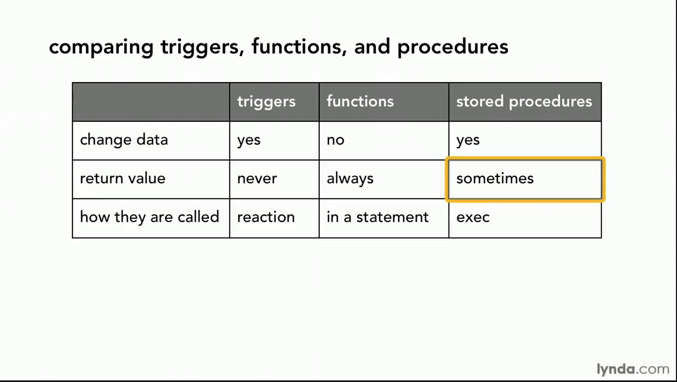
Comparison

Slide 62
Comparison – Some Details
A trigger has capabilities like a procedure, except ...
You do not call it. The DB engine calls it before or after an INSERT, UPDATE, DELETE.
The inputs are the list of incoming new, modified rows.
The outputs are the modified versions of the new or modified rows.

Slide 63
Using a Programming Language
63 | COMS W4111_002_2025_1 - Lecture 5: ER(4), Relational(4), SQL(4) © Donald F. Ferguson, 2025

Slide 64
Accessing SQL from a Programming Language
A database programmer must have access to a general-purpose programming language for at least two reasons
Not all queries can be expressed in SQL, since SQL does not provide the full expressive power of a general-purpose language.
Non-declarative actions -- such as printing a report, interacting with a user, or sending the results of a query to a graphical user interface -- cannot be done from within SQL.
Entering an address is an example that I use in my cloud computing course.

Slide 65
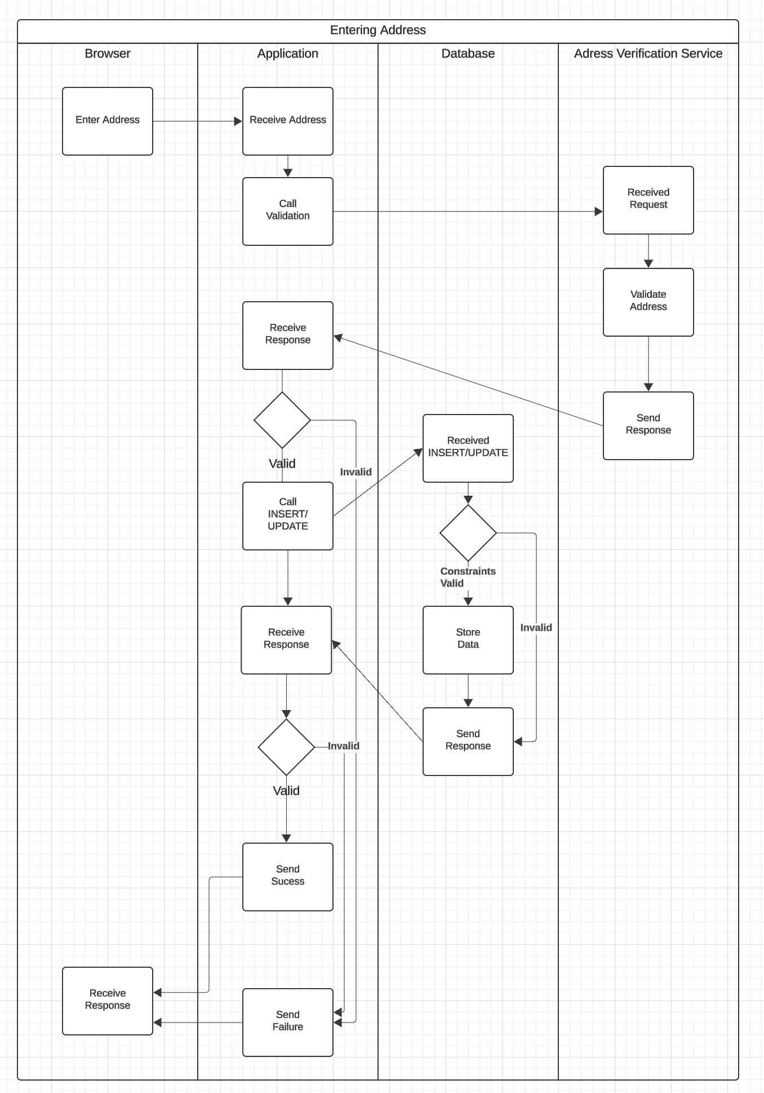
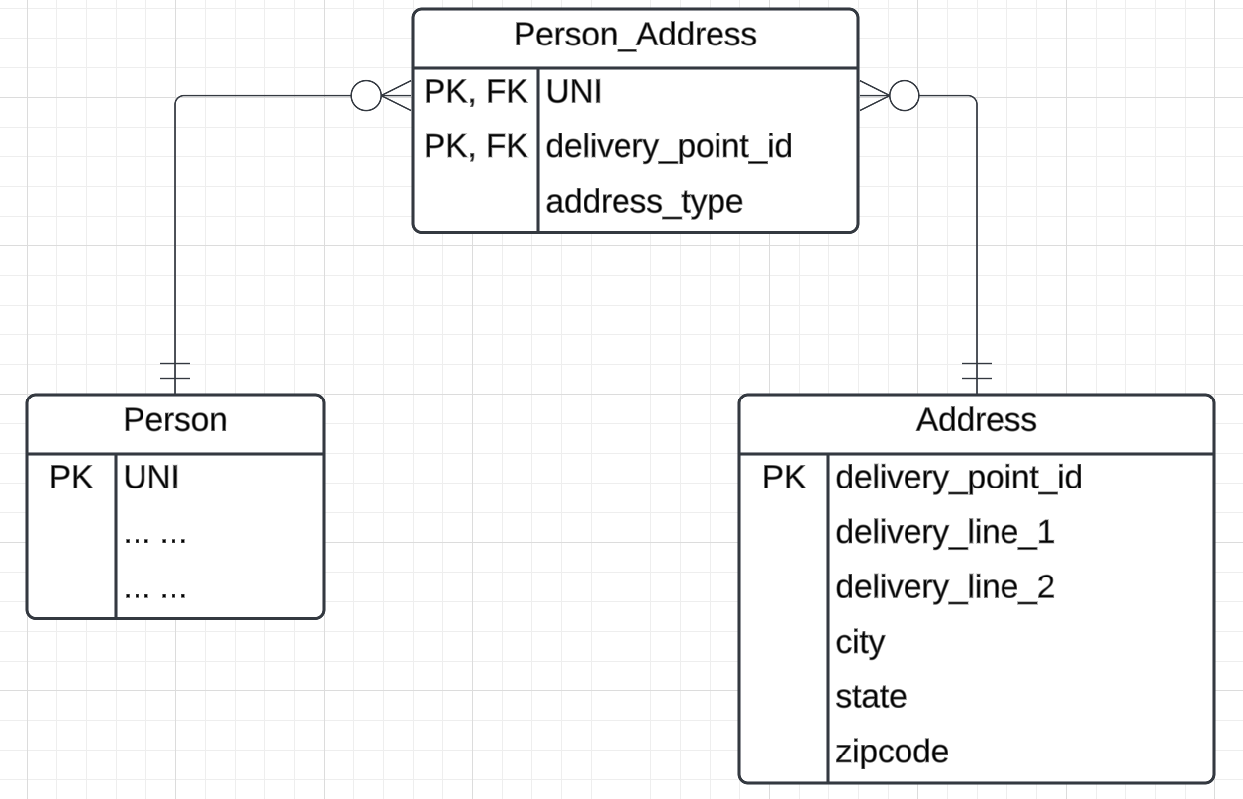
User Profile
Why application logic? An example.
People are notoriously bad at entering addresses:
520 w120th street, ny ny
520 West 120th, NYC, NY
520 w 120 street, New York city, NY
… …
Every address has a canonical format.
I want to call a cloud-based address verification service or some other validations.
Complex, multi-database application logic is very hard to write in SQL.
“Logic” in the database should focus on integrity of the data, not general purpose, complex application behavior.

Slide 66
Accessing SQL from a Programming Language (Cont.)
There are two approaches to accessing SQL from a general-purpose programming language
A general-purpose program -- can connect to and communicate with a database server using a collection of functions
Embedded SQL -- provides a means by which a program can interact with a database server.
The SQL statements are translated at compile time into function calls.
At runtime, these function calls connect to the database using an API that provides dynamic SQL facilities.

Slide 67
Some Terms
“A database connection is a facility in computer science that allows client software to talk to database server software, whether on the same machine or not. A connection is required to send commands and receive answers, usually in the form of a result set.” (https://en.wikipedia.org/wiki/Database_connection)
Session:
“Connection is the relationship between a client and a MySQL database. Session is the period of time between a client logging in (connecting to) a MySQL database and the client logging out (exiting) the MySQL database.” (https://stackoverflow.com/questions/8797724/mysql-concepts-session-vs-connection)
“A session is just a result of a successful connection.”
Network protocols are layered. You can think of:
Connection as the low-level network connection.
Session is the next layer up and has additional information associated with it, e.g. the user.
Connection libraries like pymysql sometimes blur the distinction.

Slide 68
Concepts
MySQL Workbench
… … … …
DataGrip
Relational Database Management System Instance
Blocks Files Records Offsets … …
SQL commands and result sets flow over connection in a session.
Jupyter Notebook
Logically implements query, update, insert, delete, … operations on tables.
Physical layout managed by the DBMS is not tables and is very different.
Web Application
… …
… …

Slide 69

Simplistic View
Your Application Code
mysqld
Worker Task with User ID/Role
Execute(“Some SQL Statement”)
Worker Task with User ID/Role
Worker Task with User ID/Role, properties, etc.
Language Binding/ Connector
Session Parameters and Context
Native Connector mysqlconnector
TCP/IP Connection
TCP/IP
TCP/IP Connection
TCP/IP
Operating System
Operating System
Network Messages

Slide 70
Transactions
A transaction consists of a sequence of query and/or update statements and is a “unit” of work
The SQL standard specifies that a transaction begins implicitly when an SQL statement is executed.
The transaction must end with one of the following statements:
Commit work. The updates performed by the transaction become permanent in the database.
Rollback work. All the updates performed by the SQL statements in the transaction are undone.
Atomic transaction
either fully executed or rolled back as if it never occurred
Isolation from concurrent transactions
Show connecting
Explain auto-commit

Slide 71
Applications, REST, Data Engineering Project

Slide 72
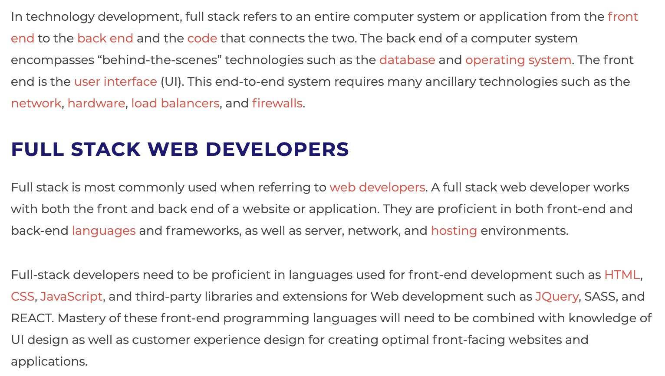
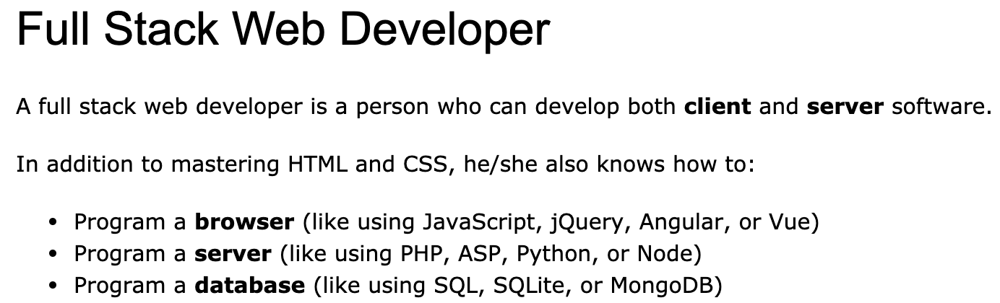
Full Stack Application
https://www.w3schools.com/whatis/whatis_fullstack.asp
There are courses that cover topics:
COMS W4153: Advanced Software Engineering
COMS W4111: Introduction to Databases
COMS W4170 - User Interface Design
This course will focus on cloud realization, microservices and application patterns, ... ...
Also, I am not great at UIs ... ... We will not emphasize or require a lot of UI work.
https://www.webopedia.com/definitions/full-stack/

Slide 73
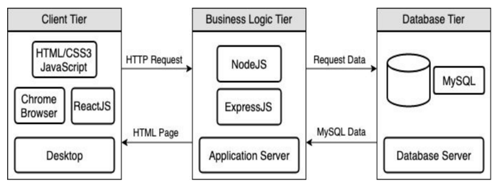
Full Stack Web Application
M = Mongo
E = Express
R = React
N = Node
I start with FastAPI and MySQL, but all the concepts are the same.
https://levelup.gitconnected.com/a-complete-guide-build-a-scalable-3-tier-architecture-with-mern-stack-es6-ca129d7df805
My preferences are to replace React with Angular, and Node with FastAPI.
There are three projects to design, develop, test, deploy, ... ...
Browser UI application.
Microservice.
Database.
The programming track will implement a simple web application to access IMDB and Game of Thrones data.

Slide 74
Some Terms
A web application server or web application framework: “A web framework (WF) or web application framework (WAF) is a software framework that is designed to support the development of web applications including web services, web resources, and web APIs. Web frameworks provide a standard way to build and deploy web applications on the World Wide Web. Web frameworks aim to automate the overhead associated with common activities performed in web development. For example, many web frameworks provide libraries for database access, templating frameworks, and session management, and they often promote code reuse.” (https://en.wikipedia.org/wiki/Web_framework)
REST: “REST (Representational State Transfer) is a software architectural style that was created to guide the design and development of the architecture for the World Wide Web. REST defines a set of constraints for how the architecture of a distributed, Internet-scale hypermedia system, such as the Web, should behave. The REST architectural style emphasises uniform interfaces, independent deployment of components, the scalability of interactions between them, and creating a layered architecture to promote caching to reduce user-perceived latency, enforce security, and encapsulate legacy systems.[1] REST has been employed throughout the software industry to create stateless, reliable web-based applications.” (https://en.wikipedia.org/wiki/REST)

Slide 75
Some Terms
OpenAPI: “The OpenAPI Specification, previously known as the Swagger Specification, is a specification for a machine-readable interface definition language for describing, producing, consuming and visualizing web services.” (https://en.wikipedia.org/wiki/OpenAPI_Specification)
Model: “A model represents an entity of our application domain with an associated type.” (https://medium.com/@nicola88/your-first-openapi-document-part-ii-data-model-52ee1d6503e0)
Routers: “What fastapi docs says about routers: If you are building an application or a web API, it’s rarely the case that you can put everything on a single file. FastAPI provides a convenience tool to structure your application while keeping all the flexibility.” (https://medium.com/@rushikeshnaik779/routers-in-fastapi-tutorial-2-adf3e505fdca)
Summary:
These are general concepts, and we will go into more detail in the semester.
FastAPI is a specific technology for Python.
There are many other frameworks applicable to Python, NodeJS/TypeScript, Go, C#, Java, … …
They all surface similar concepts with slightly different names.

Slide 76
REST and Resources

Slide 77
REST (https://restfulapi.net/)
What is REST
REST is acronym for REpresentational State Transfer. It is architectural style for distributed hypermedia systems and was first presented by Roy Fielding in 2000 in his famous dissertation.
Like any other architectural style, REST also does have it’s own 6 guiding constraints which must be satisfied if an interface needs to be referred as RESTful. These principles are listed below.
Guiding Principles of REST
Client–server – By separating the user interface concerns from the data storage concerns, we improve the portability of the user interface across multiple platforms and improve scalability by simplifying the server components.
Stateless – Each request from client to server must contain all of the information necessary to understand the request, and cannot take advantage of any stored context on the server. Session state is therefore kept entirely on the client.
Cacheable – Cache constraints require that the data within a response to a request be implicitly or explicitly labeled as cacheable or non-cacheable. If a response is cacheable, then a client cache is given the right to reuse that response data for later, equivalent requests.
Uniform interface – By applying the software engineering principle of generality to the component interface, the overall system architecture is simplified and the visibility of interactions is improved. In order to obtain a uniform interface, multiple architectural constraints are needed to guide the behavior of components. REST is defined by four interface constraints: identification of resources; manipulation of resources through representations; self-descriptive messages; and, hypermedia as the engine of application state.
Layered system – The layered system style allows an architecture to be composed of hierarchical layers by constraining component behavior such that each component cannot “see” beyond the immediate layer with which they are interacting.
Code on demand (optional) – REST allows client functionality to be extended by downloading and executing code in the form of applets or scripts. This simplifies clients by reducing the number of features required to be pre-implemented.

Slide 78
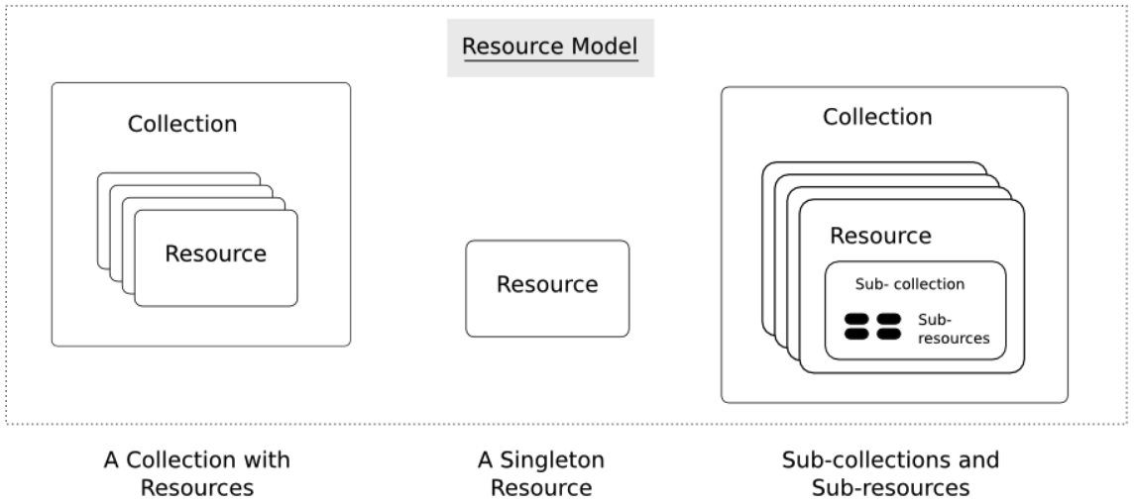
Resources
Resources are an abstraction. The application maps to create things and actions.
“A resource-oriented API is generally modeled as a resource hierarchy, where each node is either a simple resource or a collection resource. For convenience, they are often called a resource and a collection, respectively.
A collection contains a list of resources of the same type. For example, a user has a collection of contacts.
A resource has some state and zero or more sub-resources. Each sub-resource can be either a simple resource or a collection resource.
For example, Gmail API has a collection of users, each user has a collection of messages, a collection of threads, a collection of labels, a profile resource, and several setting resources.
While there is some conceptual alignment between storage systems and REST APIs, a service with a resource-oriented API is not necessarily a database, and has enormous flexibility in how it interprets resources and methods. For example, creating a calendar event (resource) may create additional events for attendees, send email invitations to attendees, reserve conference rooms, and update video conference schedules. (Emphasis added) (https://cloud.google.com/apis/design/resources#resources)
https://restful-api-design.readthedocs.io/en/latest/resources.html

Slide 79
REST – Resource Oriented
When writing applications, we are used to writing functions or methods:
openAccount(last_name, first_name, tax_payer_id)
account.deposit(deposit_amount)
account.close()
We can create and implement whatever functions we need.
REST only allows four methods:
POST: Create a resource
GET: Retrieve a resource
PUT: Update a resource
DELETE: Delete a resource
That’s it. That’s all you get.
A REST client needs no prior knowledge about how to interact with any particular application or server beyond a generic understanding of hypermedia.
“The key characteristic of a resource-oriented API is that it emphasizes resources (data model) over the methods performed on the resources (functionality). A typical resource-oriented API exposes a large number of resources with a small number of methods.” (https://cloud.google.com/apis/design/resources)

Slide 80
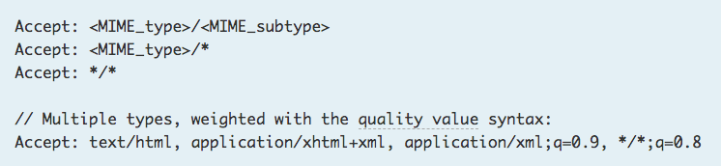
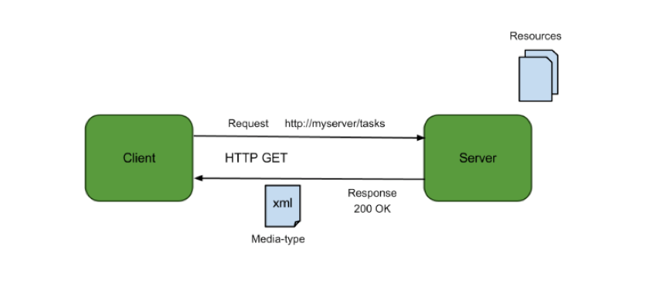
Resources, URLs, Content Types
Relative URL identifies “resource” on the server.
Server implementation maps abstract resource to tangible “thing,” file, DB row, … and any application logic.
Accept type in headers.
Client may be
Browser
Mobile device
Other REST Service
… …
Web media (content) type, e.g.
text/html
application/json

Slide 81
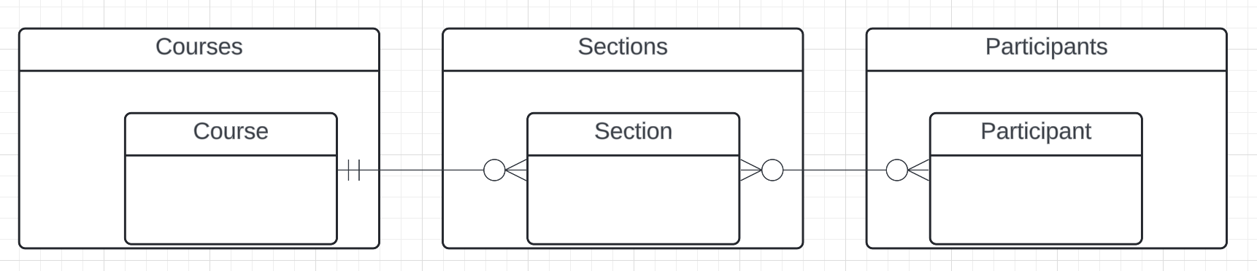
Resources and APIs
Base resources, paths and methods:
/courses: GET, POST
/courses/<id>: GET, PUT, DELETE
/sections: GET, POST
/sections/<id>: GET, PUT, DELETE
/participants: GET, POST
/participants/<id>: GET, PUT, DELETE
There are relative, navigation paths:
/courses/<id>/sections
/participants/<id>/sections
etc.
GET on resources that are collections may also have query parameters.
There are two approaches to defining API
Start with OpenAPI document and produce an implementation template.
Start with annotated code and generate API document.
In either approach, I start with models.
Also,
I lack the security permission to update CourseWorks.
I can choose to not surface the methods or raise and exception.

Slide 82
Data Modeling Concepts and REST
Almost any data model has the same core concepts:
Types and instances:
Entity Type: A definition of a type of thing with properties and relationships.
Entity Instance: A specific instantiation of the Entity Type
Entity Set Instance: An Entity Type that:
Has properties and relationships like any entity, but ...
Has at least one special relationship – contains.
Operations, minimally CRUD, that manipulate entity types and instances:
Create
Retrieve
Update
Delete
Reference/Identify/... ...
Host/database/table/pk

Slide 83
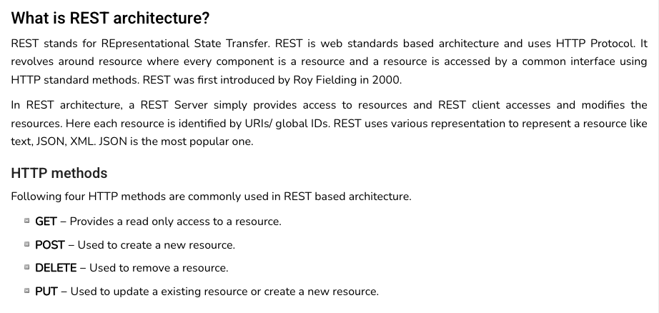
REST (https://www.tutorialspoint.com/restful/restful_introduction.htm)

Slide 84
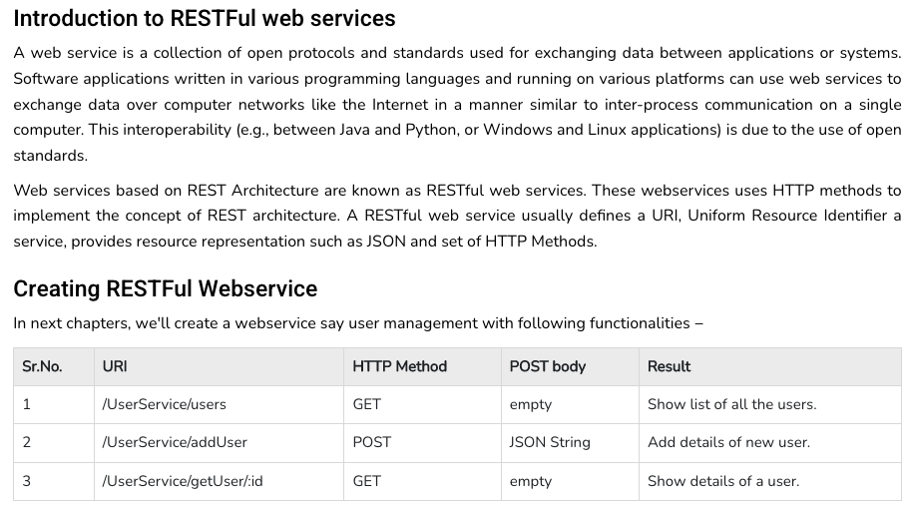
REST (https://www.tutorialspoint.com/restful/restful_introduction.htm)

Slide 85
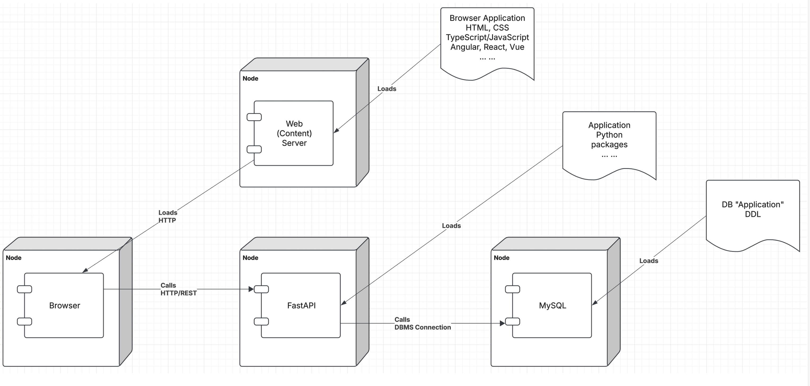
Let’s Look at the Programming Project

Slide 86
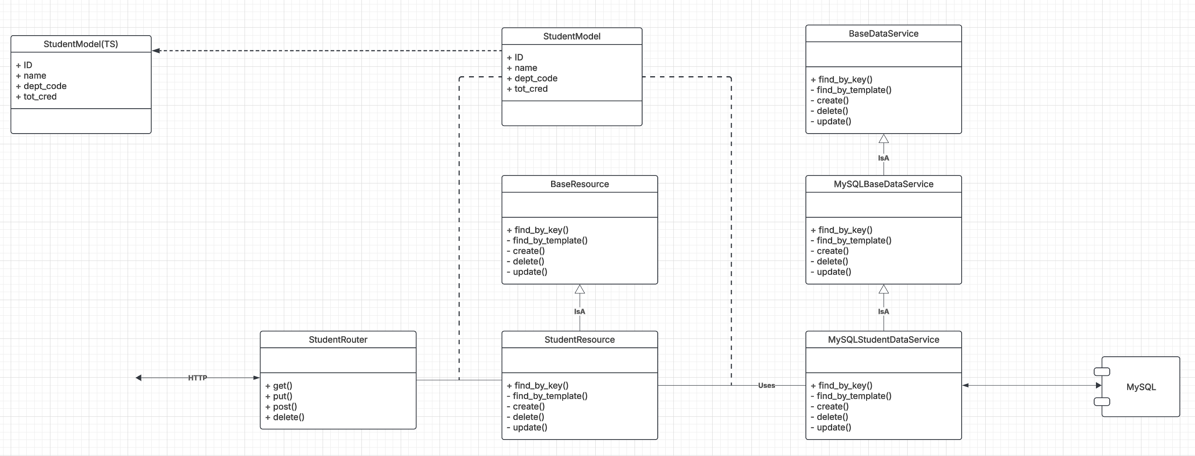
Let’s Look at the Programming Project

Slide 87
URLs

Slide 88
Simplistic, Conceptual Mapping (Examples)
REST Method | Resource Path | Relational Operation | DB Resource
DELETE | /people | DROP TABLE | people table
POST | /people | INSERT INTO PEOPLE (...) VALUES(...) | people table people row
GET | /people/21 | SHOW KEYS FROM people ...; SELECT * FROM people WHERE playerID= 21 | people row
GET | /people/21/batting | SELECT batting.* FROM people JOIN batting USING(playerID) WHERE playerID=21
GET | /people/21/batting/2004_1 | SELECT batting.* FROM people JOIN batting USING(playerID) WHERE playerID=21 AND yearID=2004 AND stint=1

Slide 89
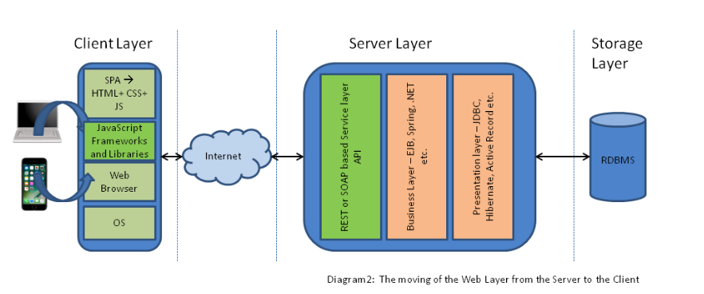
Application Architecture

Slide 90
Code
/Users/donald.ferguson/Dropbox/000/000-A-Current-Examples/W4111-FastAPI-IMDB-Solution
/Users/donald.ferguson/Dropbox/000/000-A-Current-Examples/current-dashboard

